Slide 1

SilverCity App
Authors :
Nikhil Mantri
Mohit Bohra

Slide 2

Agenda:
Why is there a need for an App?
Solution?
Know the workflow!
Any success stories ?
A look into the future..
Cloud pricing.
Any Questions?

Slide 3

Why is there a need for an app?
Taking appointment is a tedious process.
Traditionally, taking appointments is nowhere close to following the norms of social distancing!
Patients still need to carry a lot of paperwork and keep it safely which is very risk-prone.
How does a patient keep a track of his/her bills?
How do we look at the general information about the hospital and the facilities available?

Slide 4

The current situation in brief:
This Process

Slide 5

Solution?
Why not create an app for the concerned hospital where we can enable patients to book an appointment at ease and get approval as and when the doctor or the receptionist gets time?
All the patient’s data and the doctor’s data can be stored over a cloud server centrally which can be accessed by the patient or the doctor only, by a password protected entity.
We can thus go on to enable consultations and hospitalisation info and pricing to be uploaded on the cloud which can be accessed by both the counterparts from anywhere anytime, just need an android device!
We can make the app informative by providing general info of the hospital in the app itself!!

Slide 6

Thus ………

Slide 7

Wowwwww. I am excited. Show me moreeee!!!!

Slide 8
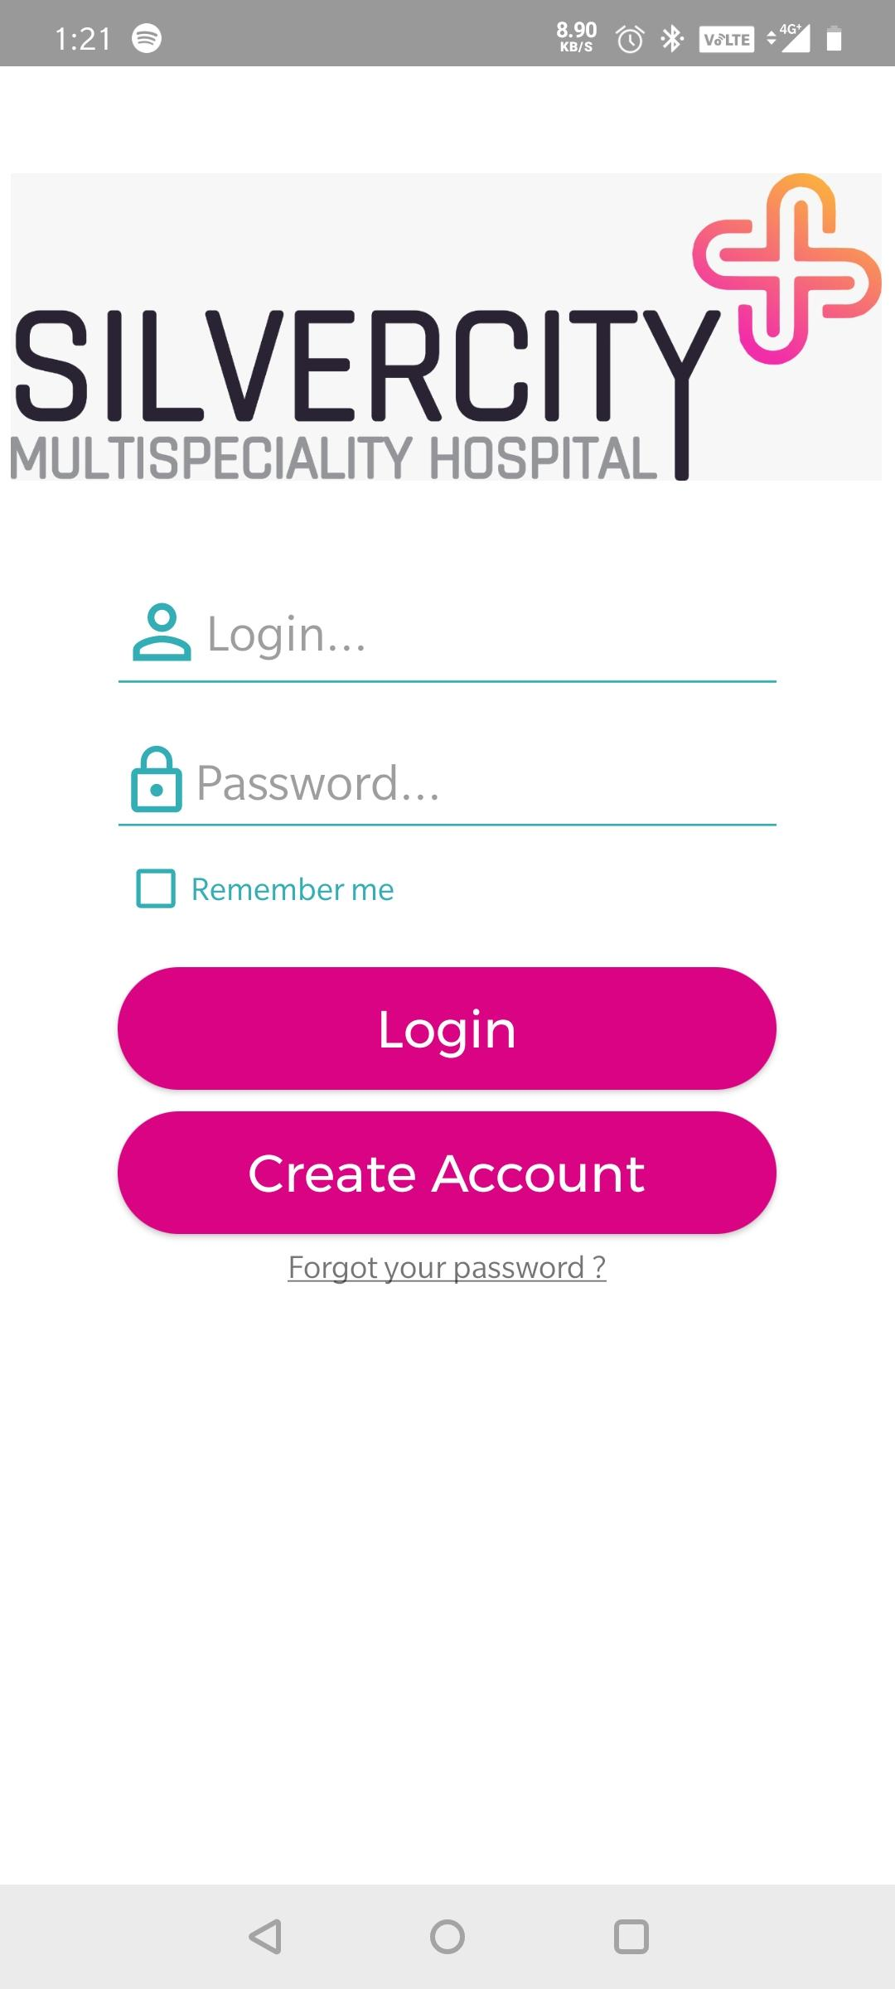
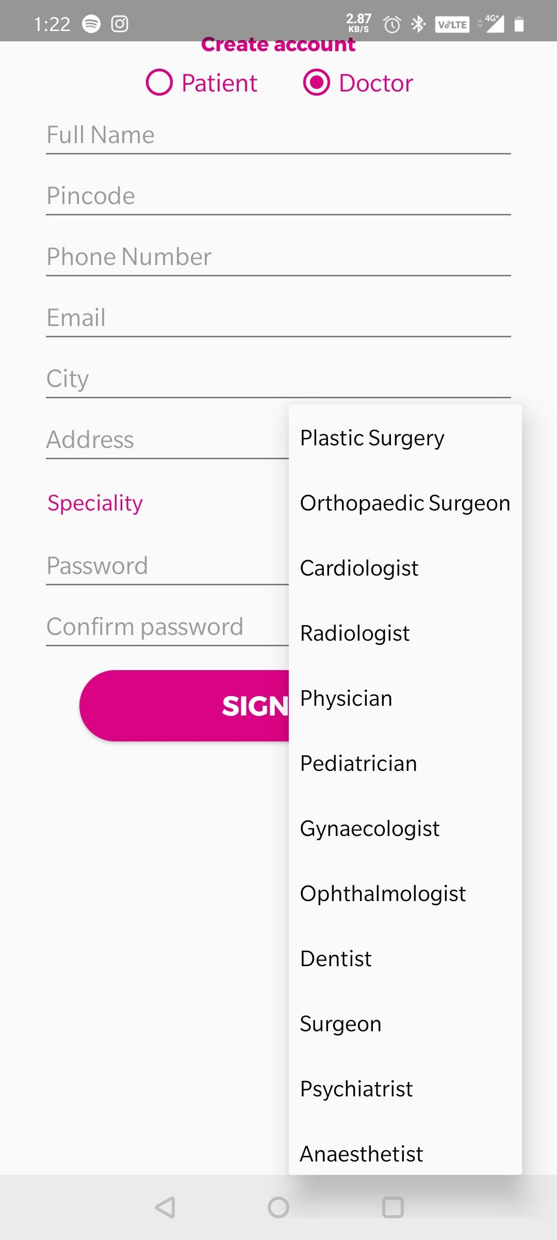
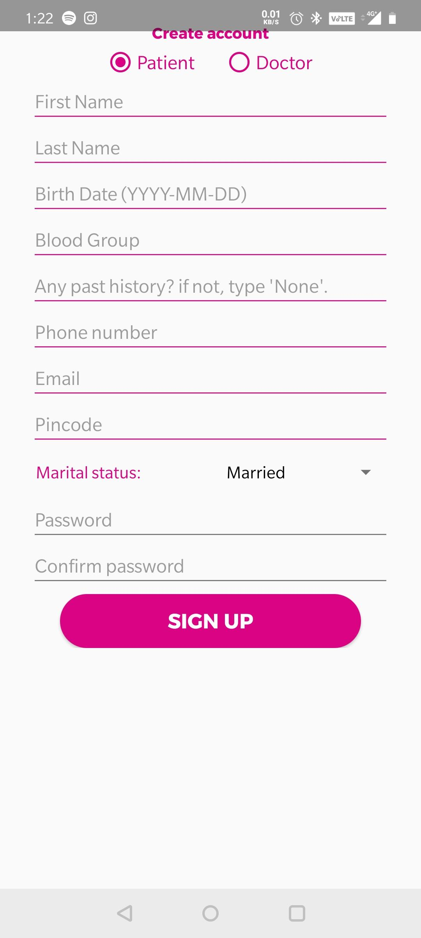
Know the Workflow!
Sign-in Page
Sign-up Doctor
Sign-up Patient

Slide 9
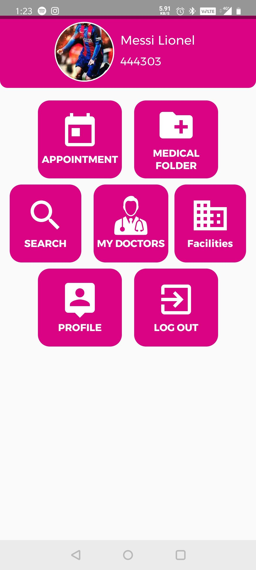
Know the Workflow!
View your records.
Takes you to the appointments window
Search doctors by speciality
Link to the silvercity website.
Edit your profile to update info
Know your previously visited doctors.

Slide 10
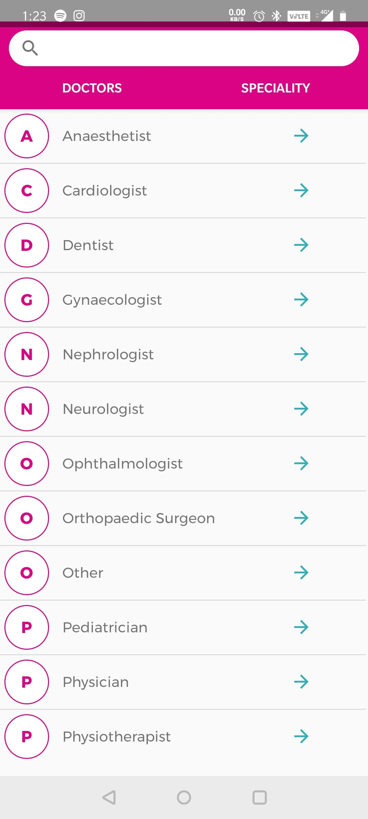
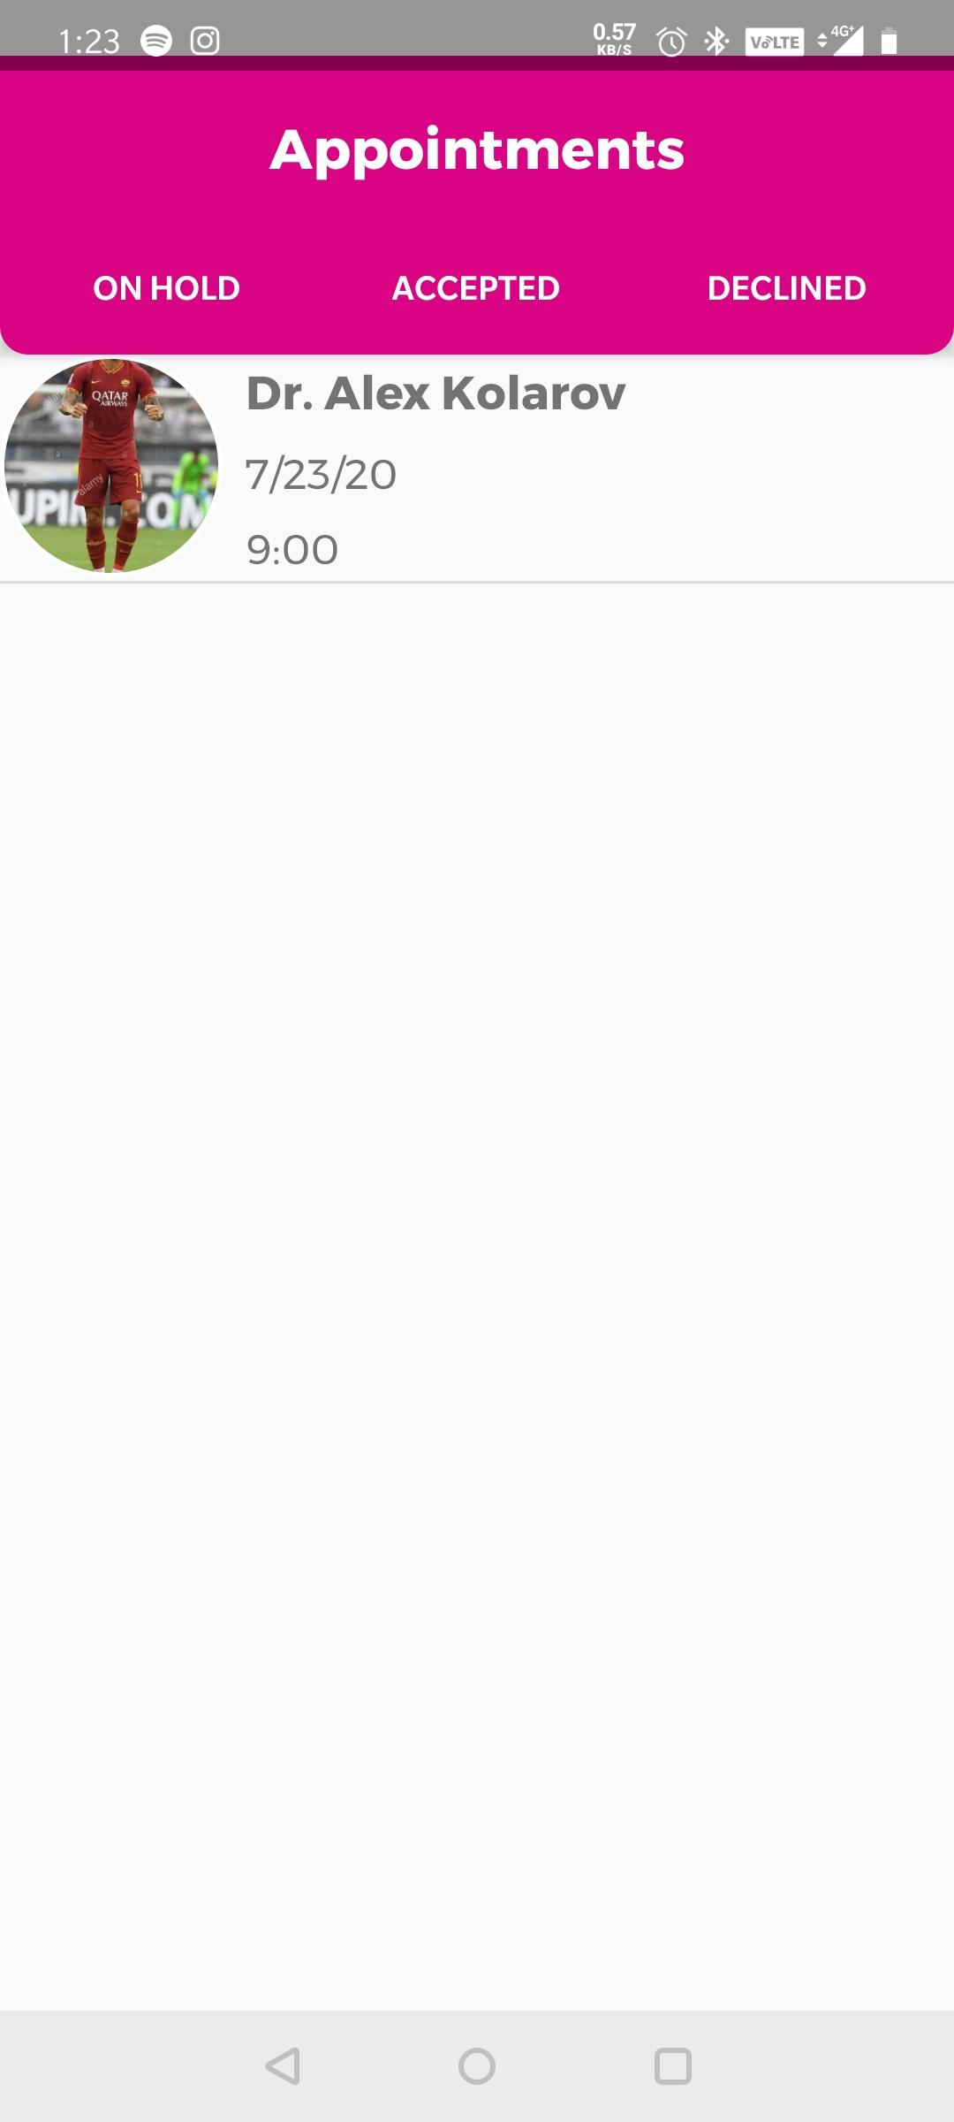
Know the Workflow!
Search your doctor!
Appointment status

Slide 11
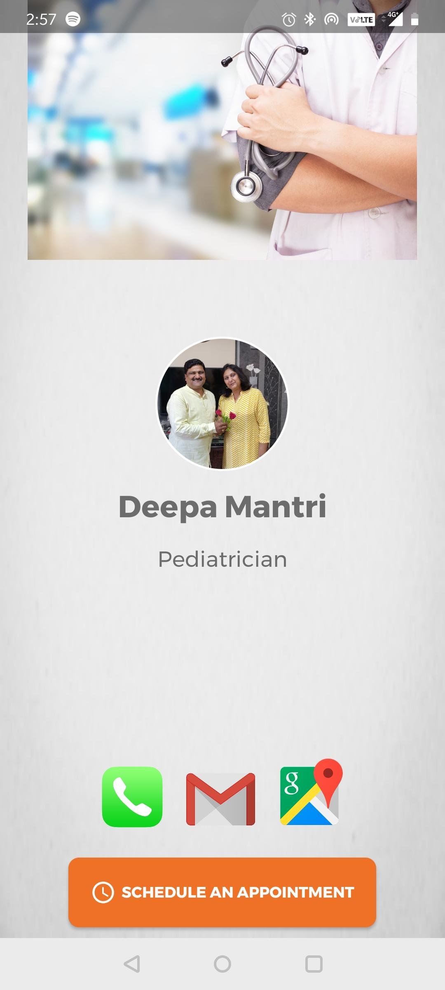
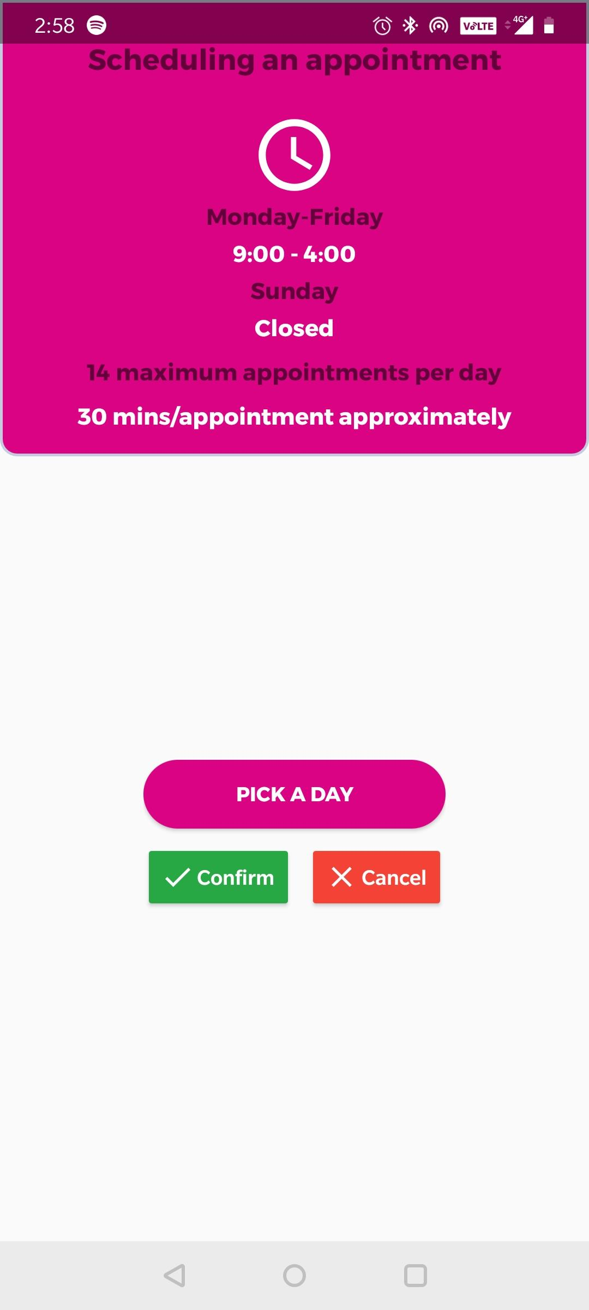
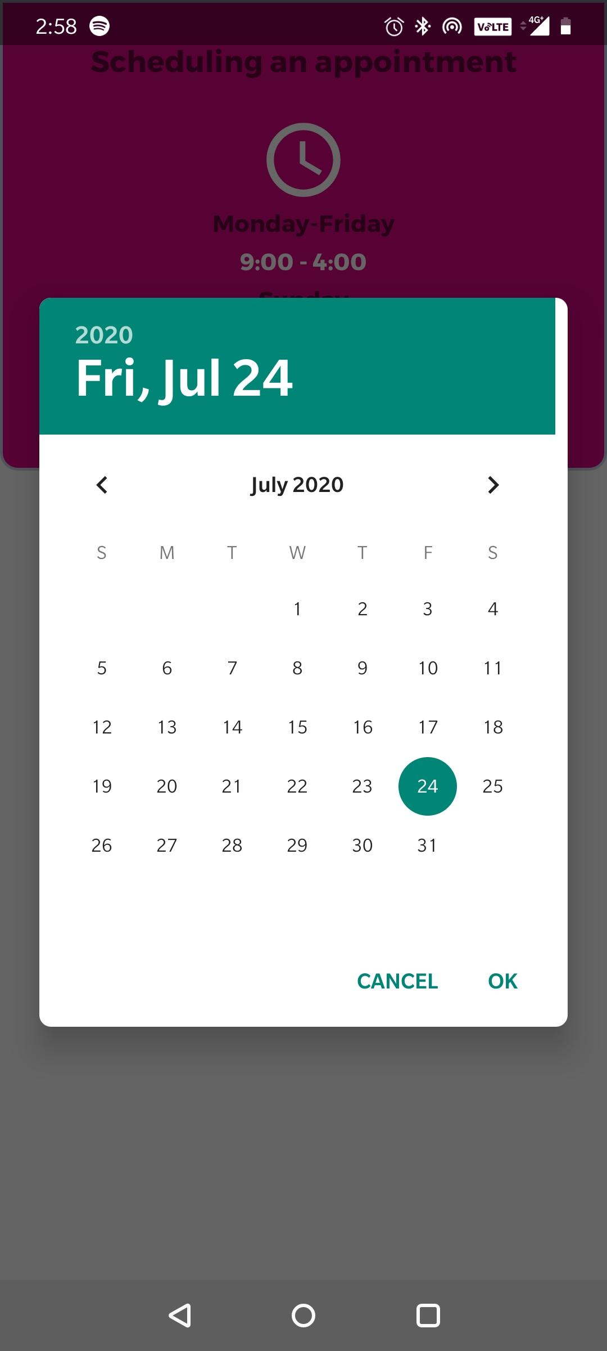
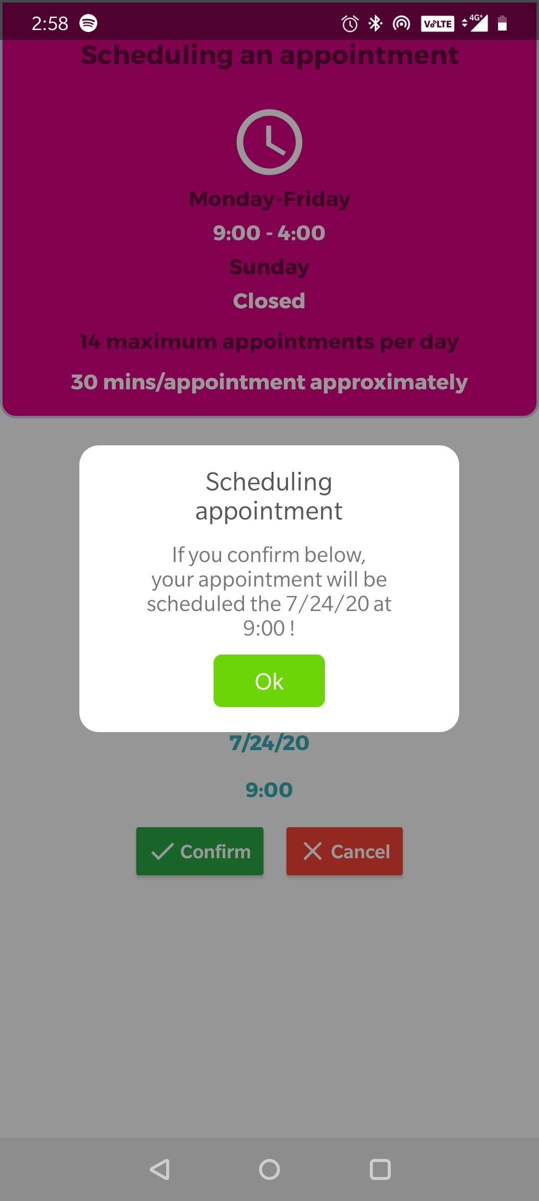
Know the Workflow!

Slide 12
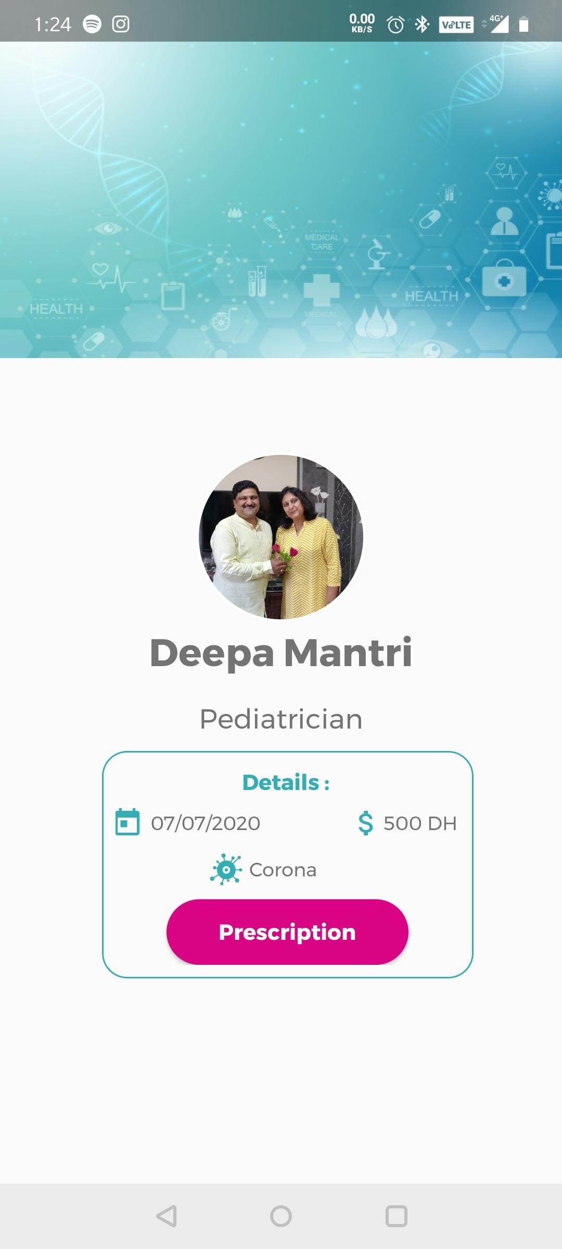
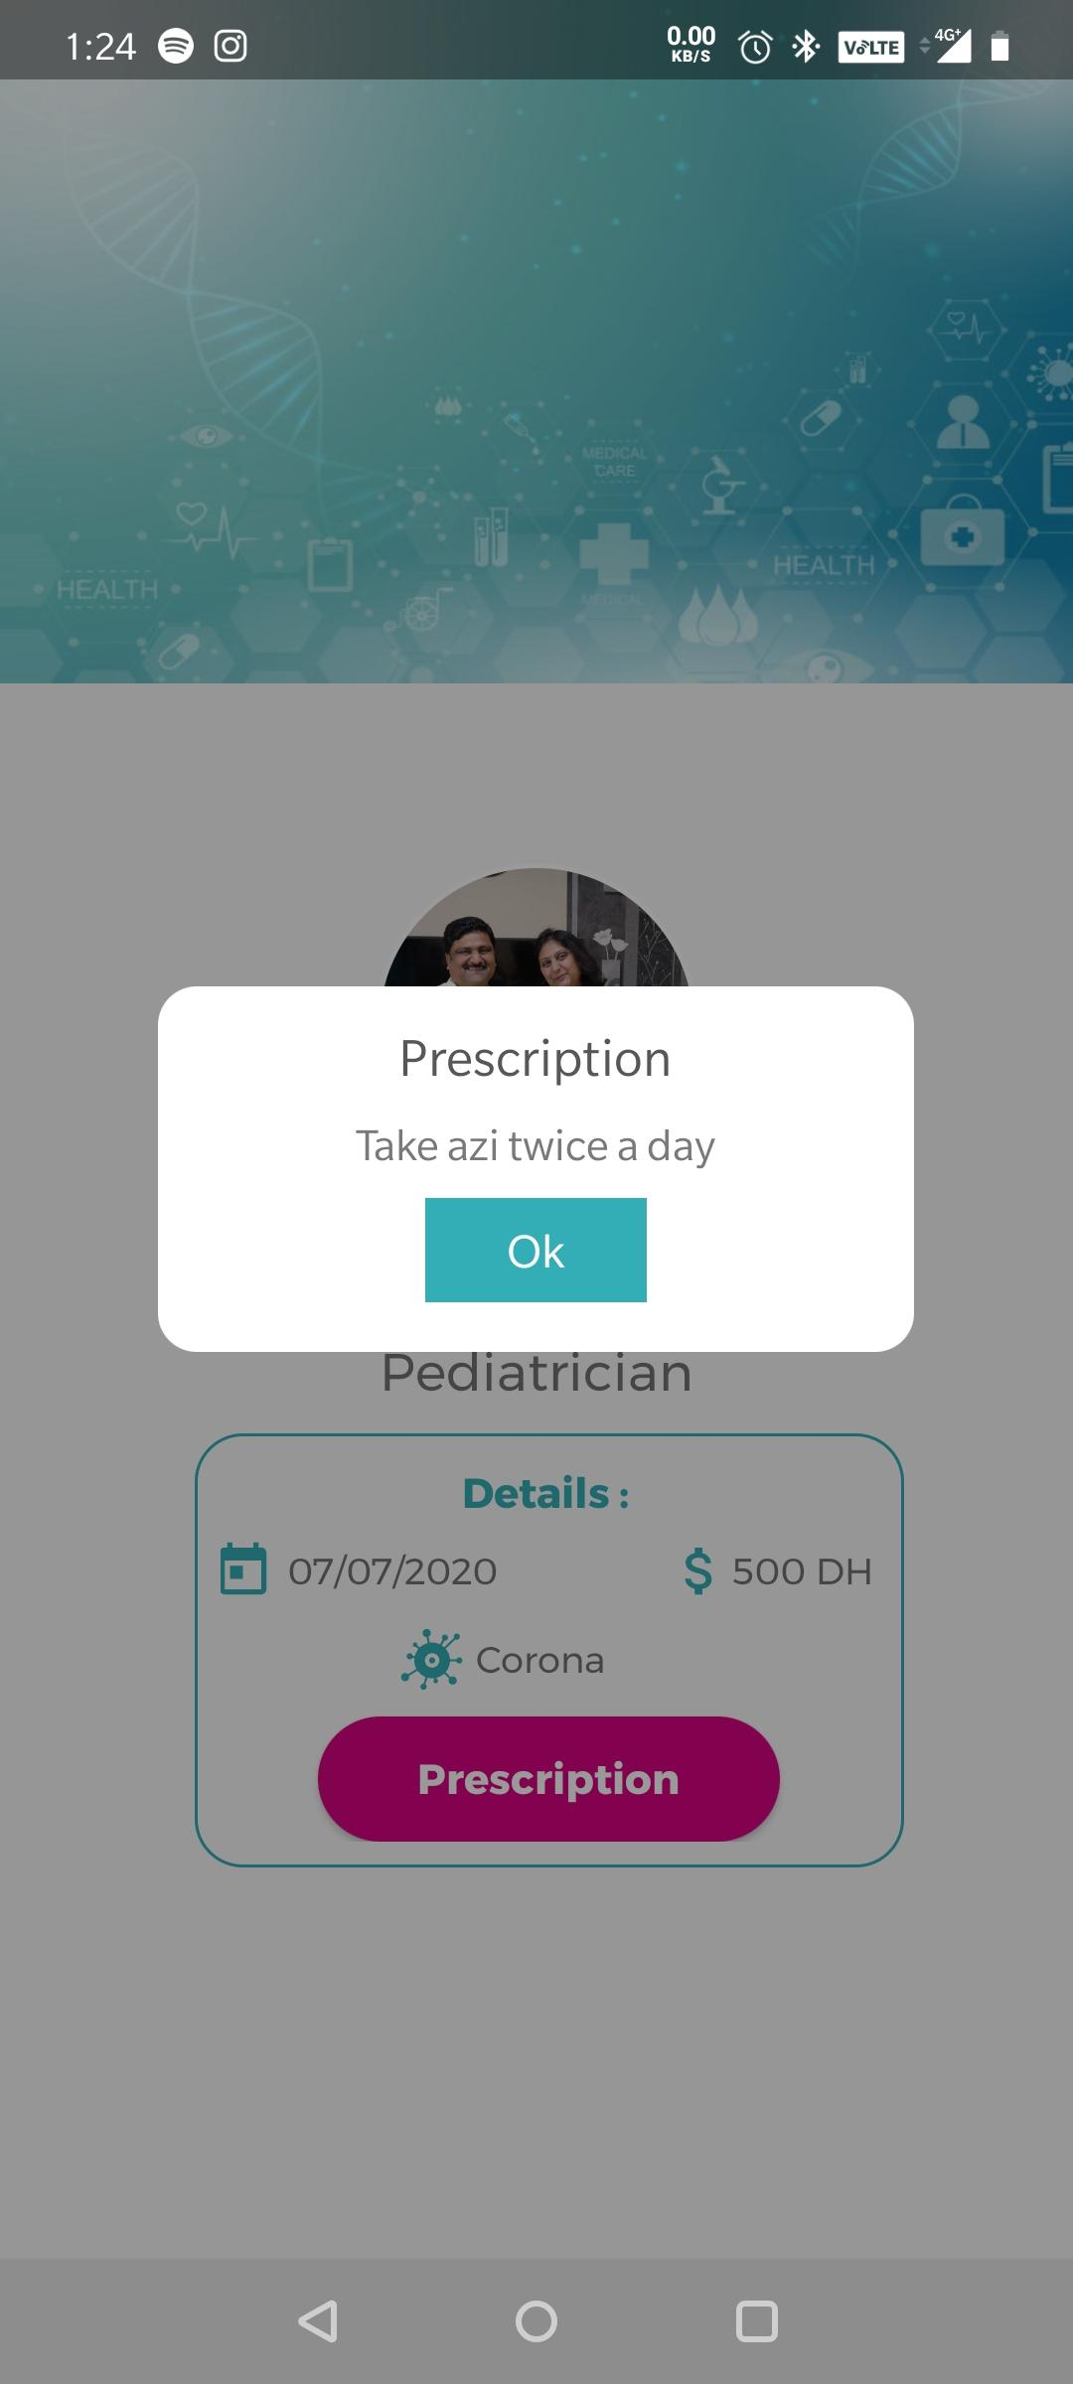
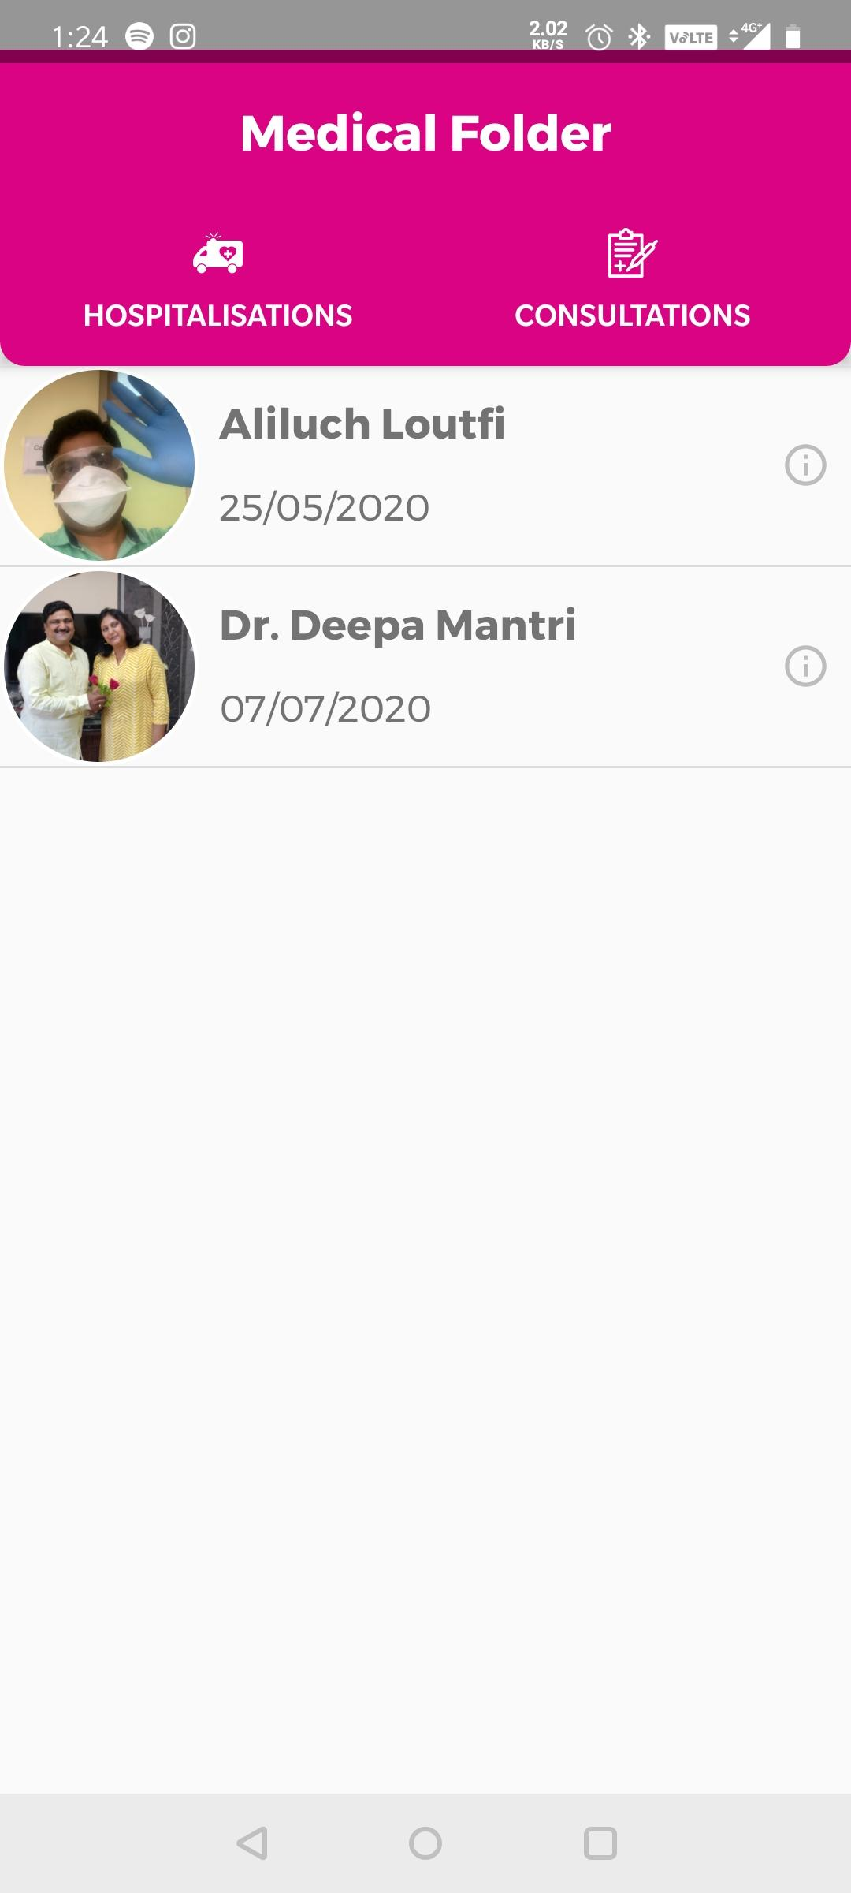
Know the Workflow!
TAP
Prescription viewing Workflow!!

Slide 13
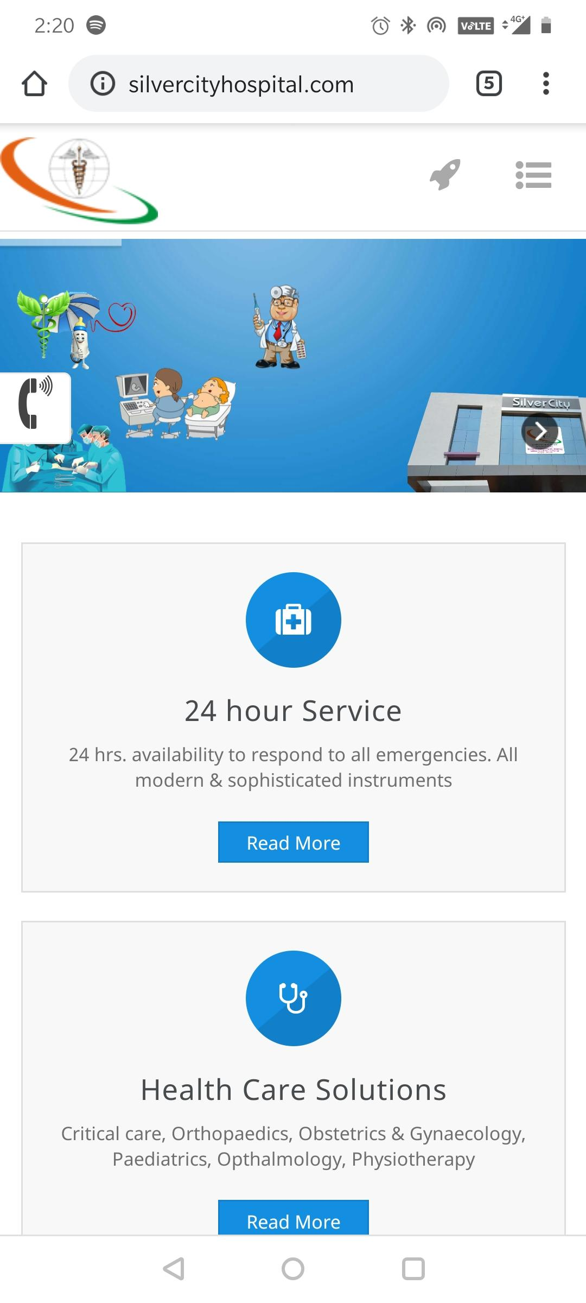
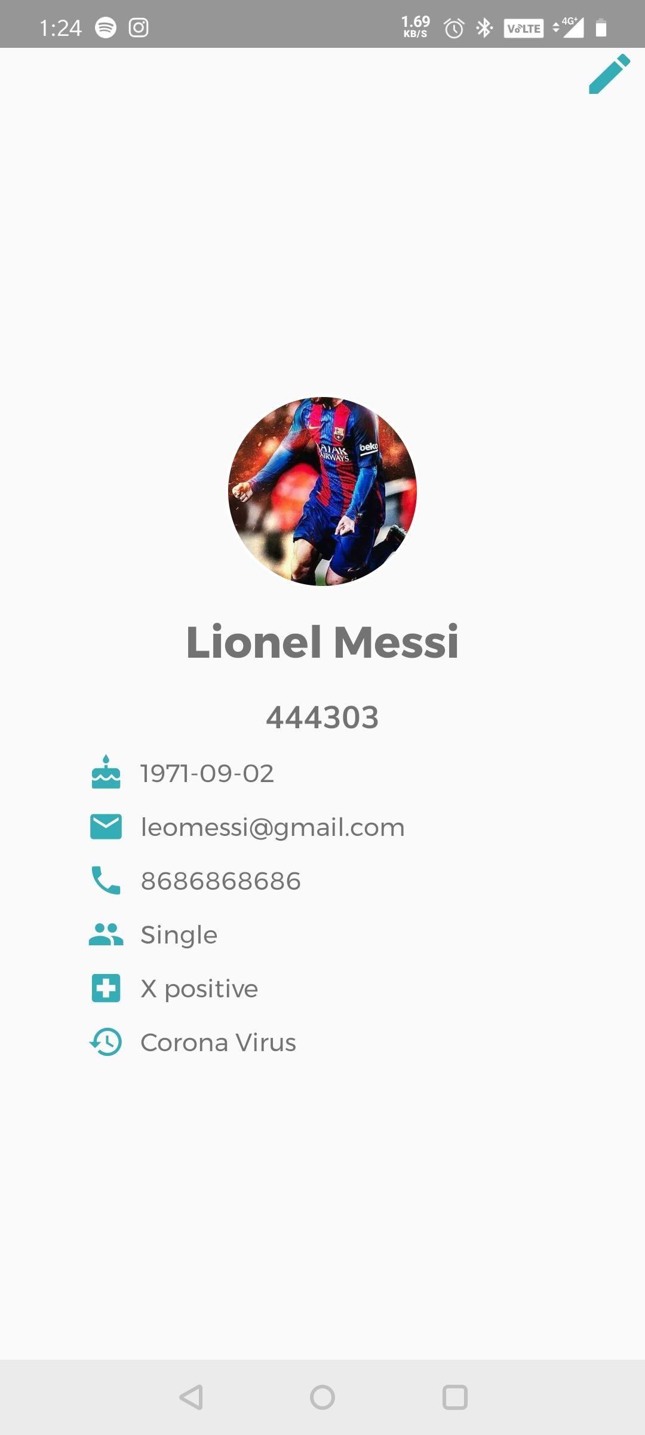
Know the Workflow!
Facilities is linked with our website. It directs us here!
Edit profile patient!

Slide 14

Know the Workflow of the Doctor UI!
What happens if I sign in as a doctor???
Let’s find out.

Slide 15
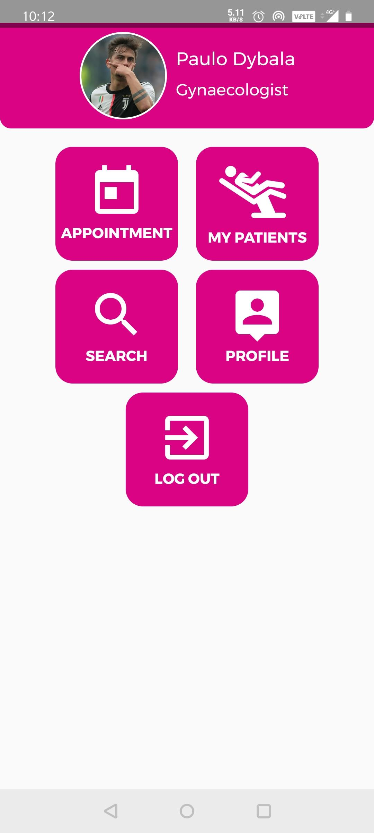
Know the Workflow of the Doctor UI!
View on hold, accepted and the appointments declined by you.
View your patients and add medical records
Search Patients.
View and edit your own profile.
Log out of here.
Signed-in as a doctor

Slide 16
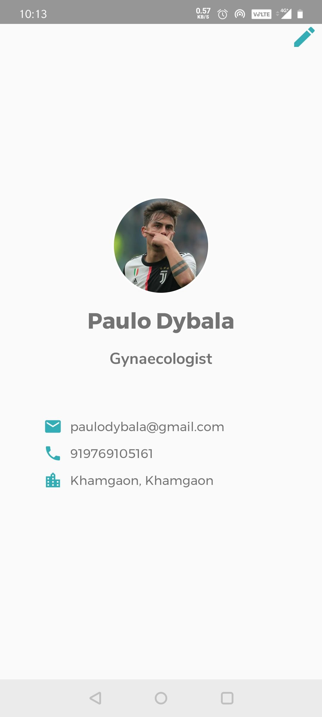
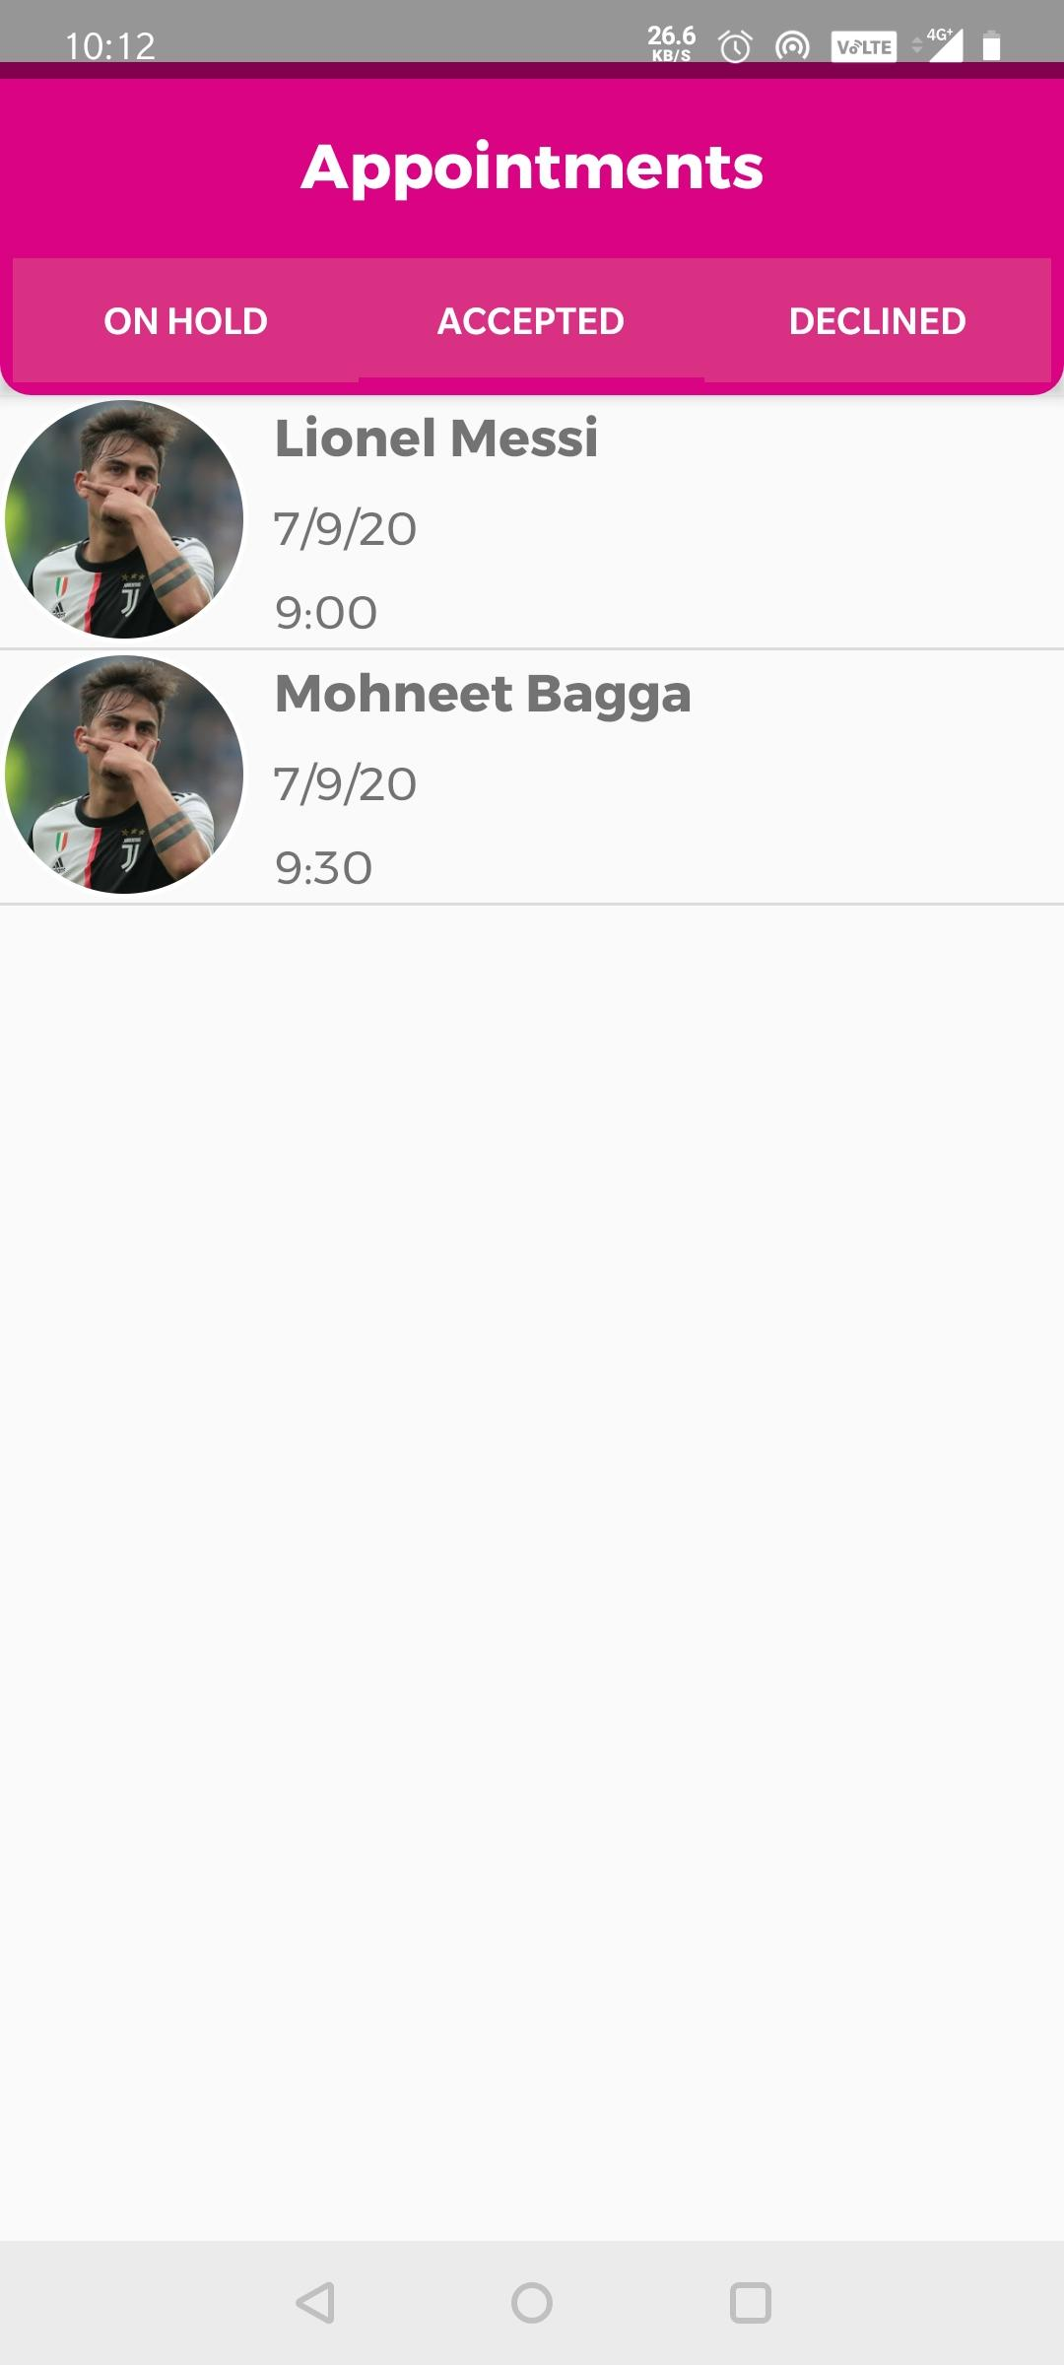
Know the Workflow of the Doctor UI!
Appointments fragment.
Edit profile fragment.

Slide 17


Know the Workflow of the Doctor UI!
But guys, how do I add consultation info or prescriptions for my patients?
I know that! Let me show you how….

Slide 18
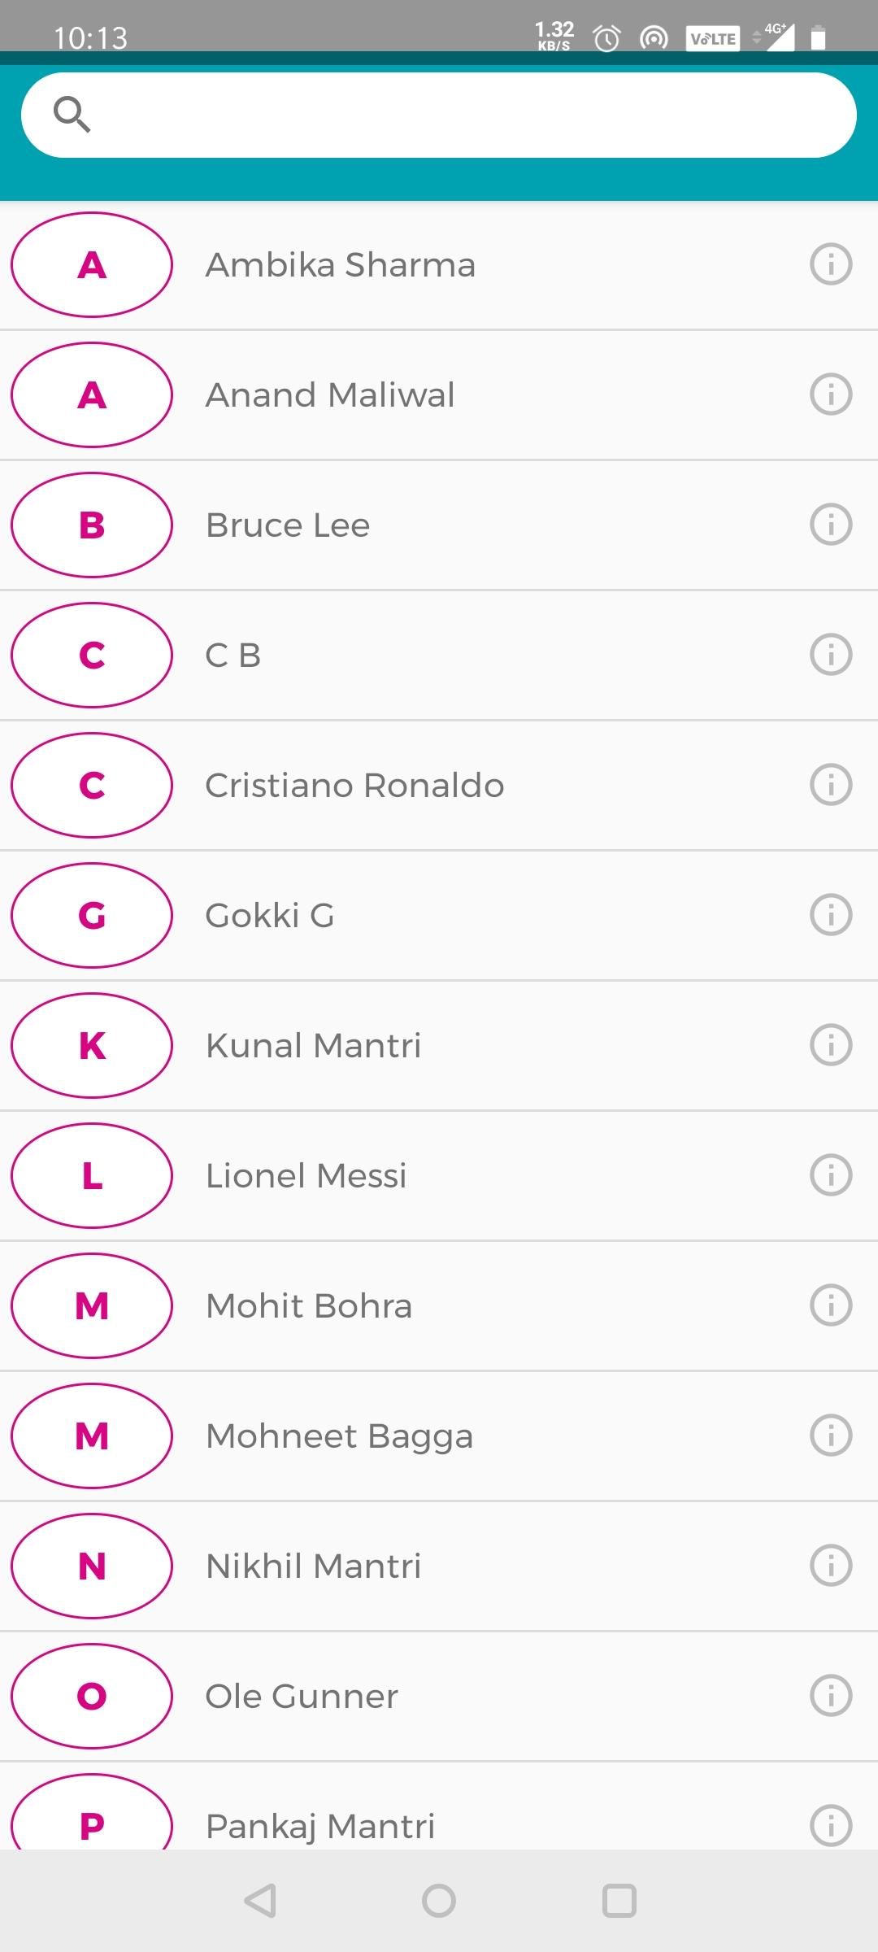
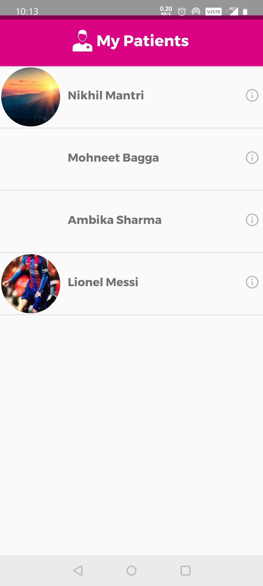
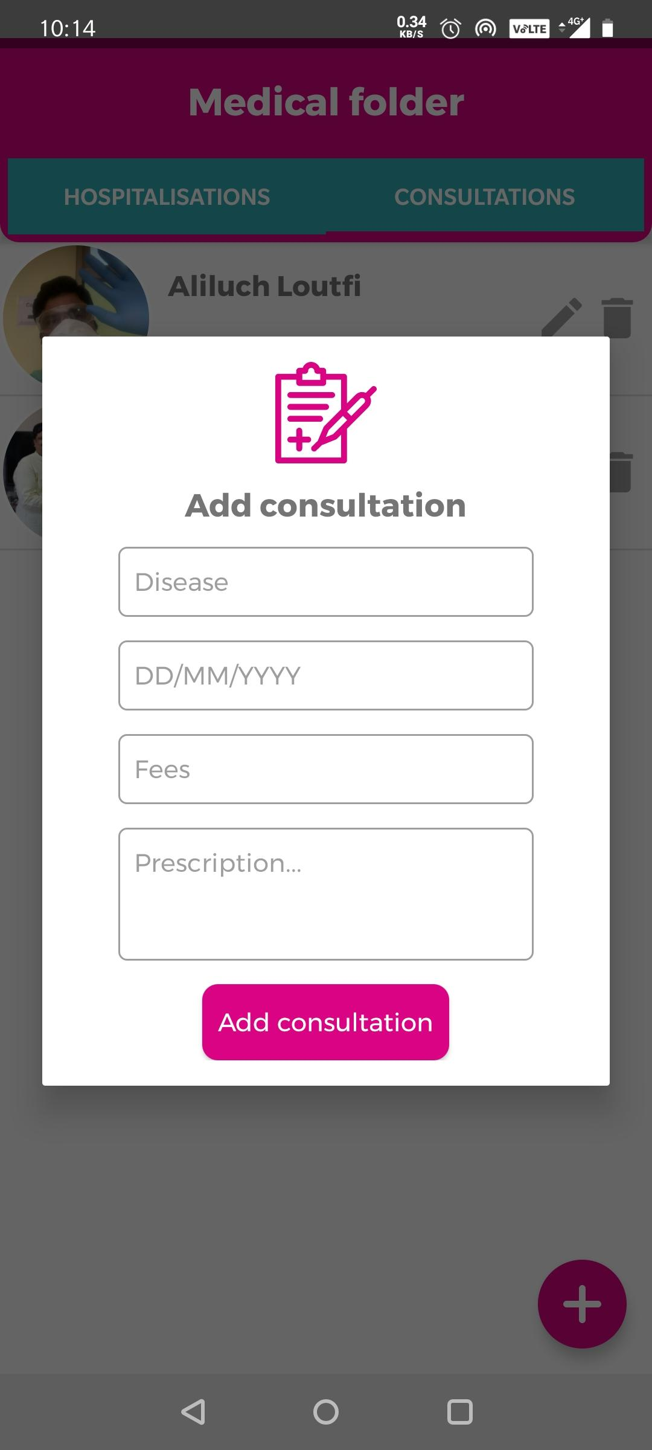
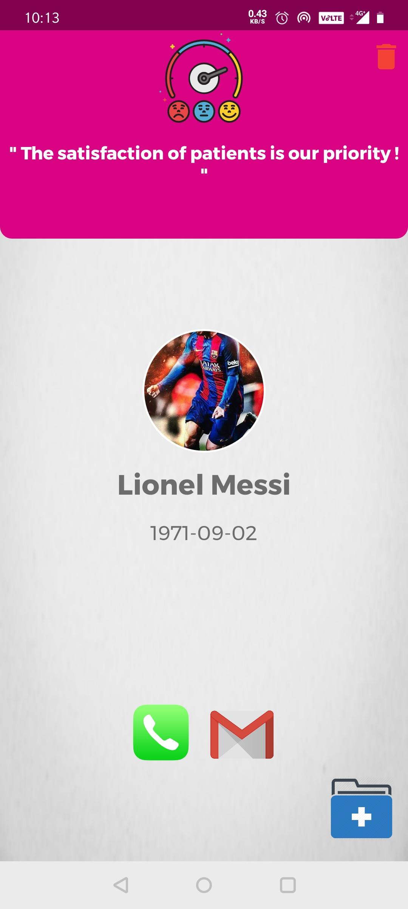
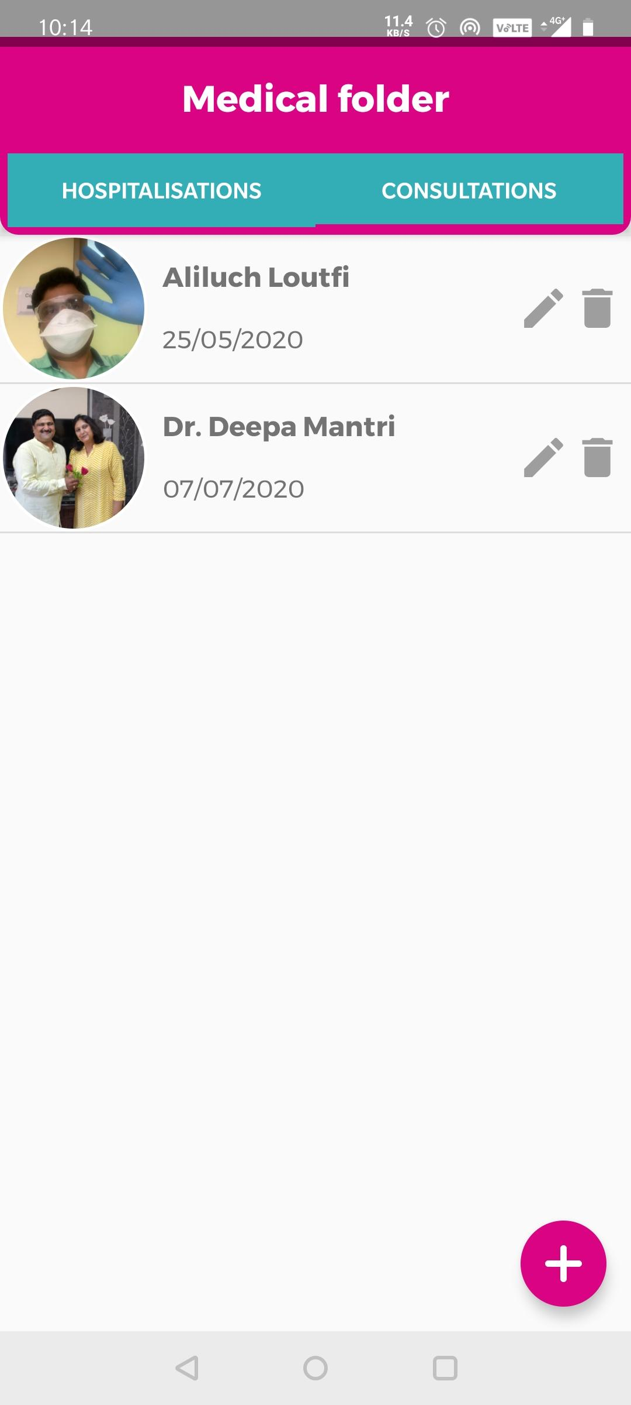

Slide 19
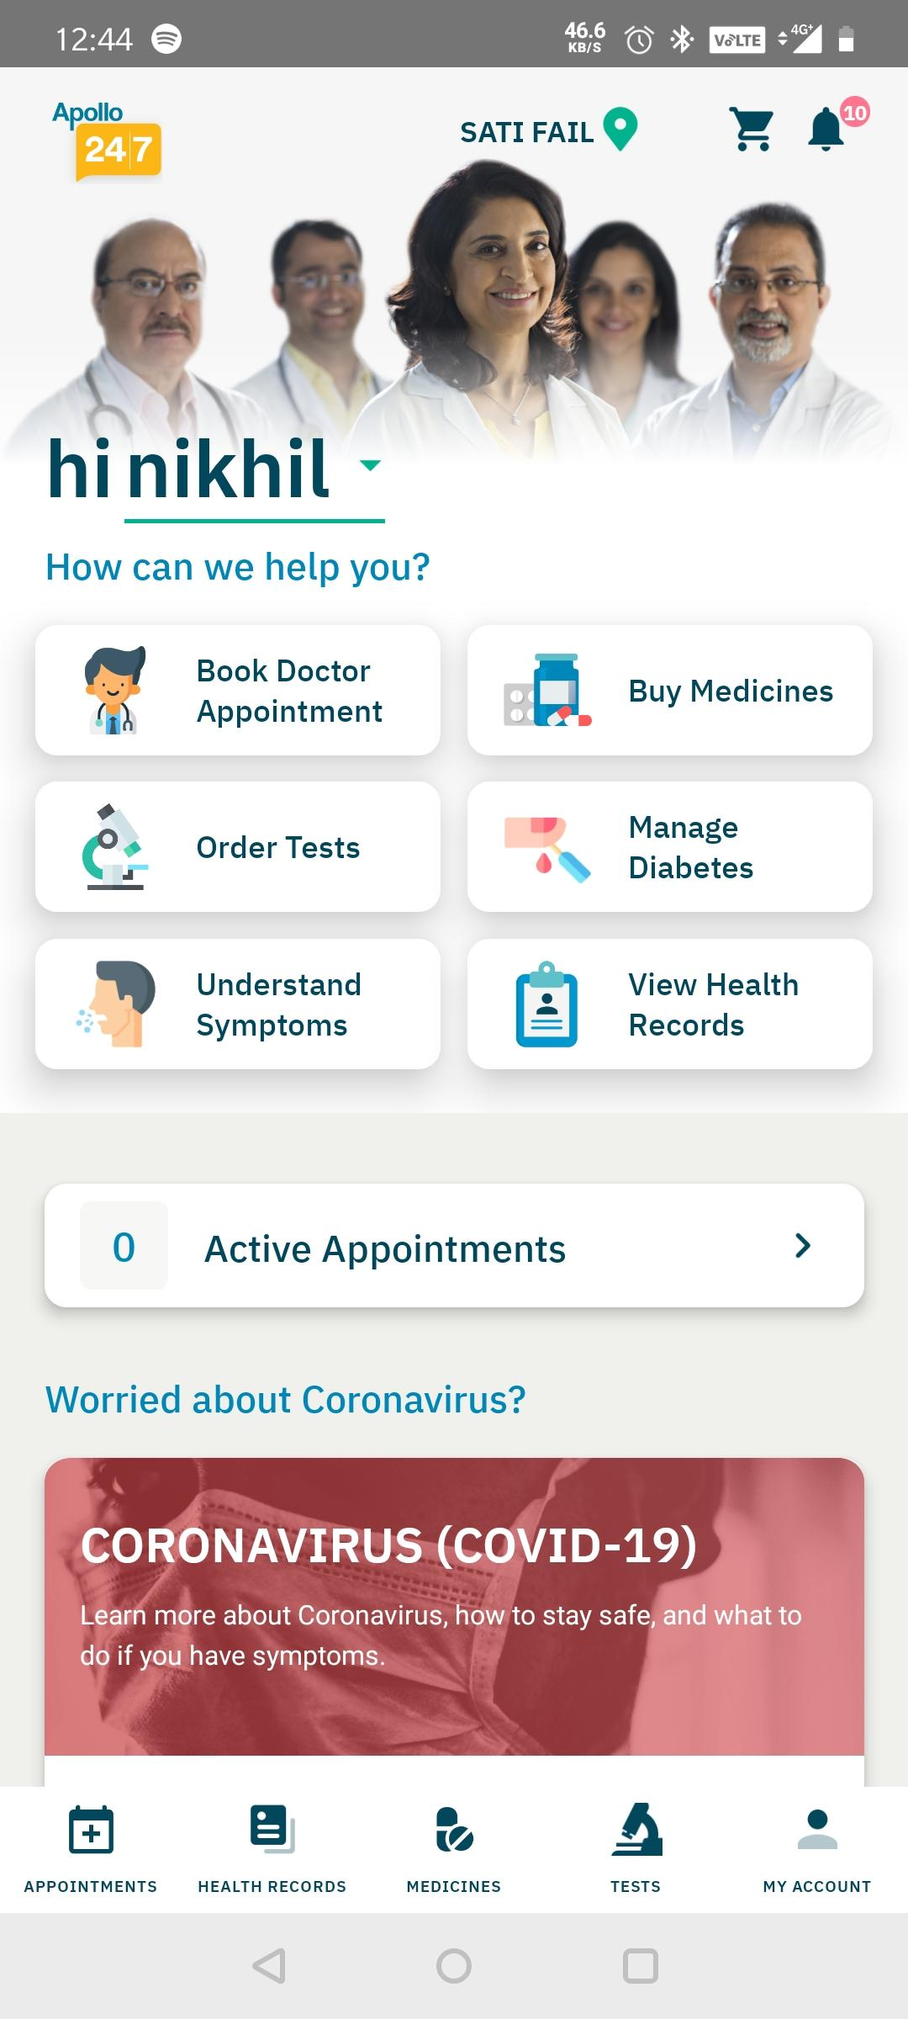
Know the Workflow of the Doctor UI!
Any success stories yet?
Apollo group of hospitals and doctors has a similiar app with 10 lakh+ downloads on Playstore and a rating of 4 out of 5 stars.

Slide 20

Know the Workflow of the Doctor UI!
Future plans?
A Camscanner plugin to take picture of
prescriptions and upload it to the
Consultations.
Online Consultations, for example
modern day dermatologists.
Directing a patient to a doctor
based on his/her symptoms.
Booking tests like Blood tests, MRI etc.
In-App medical store.

Slide 21

Know the Workflow of the Doctor UI!
Cloud Pricing!
The official firebase pricing link!

Slide 22

Know the Workflow of the Doctor UI!
Questions peeps???

